Slide 1
ONLINE FOOD ORDERDING SYSTEM
Srivatsen s
Roshan R

Slide 2
INTRODUCTION
Background: The rising demand for online food delivery due to changing consumer lifestyles and digital adoption.
Increased reliance on digital platforms for quick meals and convenience.
The impact of third-party delivery apps (e.g., Zomato, Swiggy, Uber Eats) on restaurant business models.
Challenges in traditional ordering: slow processing, lack of visibility, minimal customer engagement.
Motivation: Build a scalable, easy-to-use system for all stakeholders.

Slide 3
EXISTING SYSTEM
Manual processes: food orders are often taken by phone or in-person at restaurants.
Paper-based records for menu management and order transactions.
No 24/7 availability—dependent on restaurant opening hours and staff presence.
Limited reach: only local customers, minimal marketing.
Inflexible: Difficult to handle bulk orders, track order status, or quickly update menus and pricing.

Slide 4
DISADVANTAGES OF EXISTING SYSTEM
High probability of human errors in note-taking, communication, and billing.
Frequent misunderstandings on order details or delivery addresses.
Lost business during busy periods or after hours; missed calls = missed sales.
No mechanism for real-time order tracking for customers or restaurants.
Time-consuming; reduces restaurant staff efficiency and increases wait times.
Customer dissatisfaction due to poor communication and delays.

Slide 5
PROPOSED SYSTEM
Online portal/app available 24/7 for browsing and ordering food.
Menu search and filtering by restaurant, cuisine, price, or ratings.
Secure registration, login, and session management for users and admins.
Cart management with real-time updates and order summaries.
Multiple payment options and secure transactions.
Automated order processing and electronic records.
Real-time order status updates (pending, preparing, delivered).
Admin and restaurant-owner modules for managing menus, orders, and analytics.
Feedback and rating features to improve service quality.

Slide 6
SYSTEM ARCHITECTURE
Client-side: JSP pages, HTML, CSS, JavaScript for interactive and responsive UI.
Server-side: Java Servlets for handling business logic, order processing, and user sessions.
Database: MySQL for storing users, restaurants, menu items, and order histories.
Architecture Style: Follows MVC (Model-View-Controller) pattern for maintainability.
RESTful endpoints for handling cart operations, orders, and admin tasks.
Security: Input validation, authentication, and authorization.
Scalable for integration with APIs (e.g., payment gateways, SMS notifications).

Slide 7
DATABASE DESIGN:CORE ENTTIES
User/Customer: user_id (Primary Key) - Unique identifier, full_name - Customer's full name, email - Email address (unique), password - Encrypted password, phone - Contact number, address - Delivery address, role - User role (customer, admin, restaurant_owner), created_at - Registration timestamp
Restaurant: restaurant_id (Primary Key) - Unique identifier, name - Restaurant name, cuisine_type - Type of cuisine (Italian, Chinese, etc.), description - Restaurant description, address - Physical location, rating - Average customer rating, delivery_time - Estimated delivery time, image_url - Restaurant image
Menu Item: menu_item_id (Primary Key) - Unique identifier, restaurant_id (Foreign Key) - References Restaurant, name - Dish name, description - Item description, category - Food category (appetizer, main, dessert), price - Item price, image_url - Dish image, available - Availability status

Slide 8
DATABASE DESIGN:CORE ENTTIES
4. Order: order_id (Primary Key) - Unique identifier, user_id (Foreign Key) - References User, restaurant_id (Foreign Key) - References Restaurant, delivery_address - Delivery location, contact_number - Customer contact, total_amount - Order total, status - Order status (pending, preparing, delivered), payment_method - Payment type (COD, card, UPI), created_at - Order timestamp
5. Order Details: order_detail_id (Primary Key) - Unique identifier, order_id (Foreign Key) - References Order, menu_item_id (Foreign Key) - References Menu Item, quantity - Number of items, price - Item price at time of order
6. Cart: cart_id (Primary Key) - Unique identifier, user_id (Foreign Key) - References User, menu_item_id (Foreign Key) - References Menu Item, quantity - Number of items, created_at - Added timestamp

Slide 9
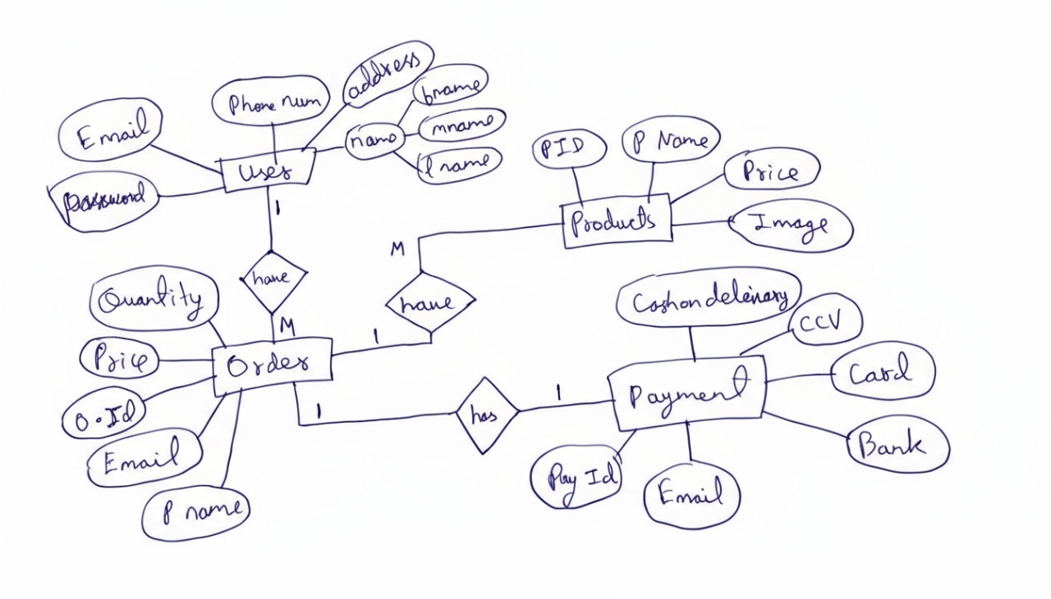
ER DIAGRAM

Slide 10
CONCLUSION
The project successfully digitizes food ordering, reducing human error and improving speed.
Provides added value to both restaurant owners and customers through improved visibility and options.
Scalable structure enables easy future enhancements (mobile app, AI recommendations, real-time tracking).
Contributes to digital transformation and competitive advantage for restaurants.
Empowers users with convenience and a seamless experience in dining and delivery.

